Slide 1
ASU Data Analytics Project 1: Gold Price Prediction VS Inflation 2013 - 2021

Slide 2
Sources Used:
Currency Specific Gold Valuations [ Yahoo Finance ]:
UnitedStates: https://finance.yahoo.com/quote/USD%3DX/history?p=USD%253DX![image](https://github.com/BrennanB572/Gold_Price_vs_Inflation/assets/114636599/4c558ba4-627e-4eeb-bf2a-be679717fdaa)
China: https://finance.yahoo.com/quote/CNYUSD%3DX/history?p=CNYUSD%253DX![image](https://github.com/BrennanB572/Gold_Price_vs_Inflation/assets/114636599/4475262a-ee8c-42f3-934b-f13661f64c5b)
Europe: https://finance.yahoo.com/quote/EURUSD%3DX/history?p=EURUSD%3DX&guccounter=1![image](https://github.com/BrennanB572/Gold_Price_vs_Inflation/assets/114636599/002c5590-6855-4540-a99e-3ddd4dd4b265)
Russia: https://au.finance.yahoo.com/quote/RUBUSD%3DX/history?period1=1356998400&period2=1672444800&interval=1d&filter=history&frequency=1d&includeAdjustedClose=true![image](https://github.com/BrennanB572/Gold_Price_vs_Inflation/assets/114636599/cb61f335-8cf1-44ea-9631-2a0e38b7046e)
Inflation Rates:
All Countries: Gold Price Prediction | LSTM | 96% Accuracy - https://www.kaggle.com/code/farzadnekouei/gold-price-prediction-lstm-96-accuracy/output

Slide 3
Overview
The Gold Price vs. Inflation 2013 - 2021 main goal is to identify Gold vs Inflation trends for the United States, Russia, China and Europe from 2013 - 2021. The end goal analysis is to answer 6 key questions:
Where is the money lowest inflation?
What currency experience the highest inflation?
What currency experience the lowest inflation?
Is it profitable to move money?
What currency has the consistent value range for the longest time?
What currency has the least consistent value range for the longest time?

Slide 4
Hypothesis
Below are the 3 main hypothesis for this project:
Highest Inflation Country: Team Decision - United States
Lowest Inflation Country: Team Decision - Russia
Currency vs. Gold Hypothesis: As the currency deflates the currencies' ability to purchase gold increases. If inflation is in a nonstandard range, then currency will be safer kept in gold over time.

Slide 5
Team Roster / Roles
Juan Herrera Sebastian
- [ Code Architect ]
Juan was responsible for handling the A to Z code structure.
Country Assignment: Russia / Ruble Analysis
Brennan Bradley
- [ Version Control Architect ]
Brennan was responsible for handling file organization and github merges/debugging.
Country Assignment: United States / Dollar Analysis
Christian B
- [ Code Adaptation Specialist ]
Christian was responsible for handling code commenting and code direction for accomplishing end analysis.
Country Assignment: Europe / Euro Analysis
Ritika Changulani
- [ Presentation Design Lead ]
Ritika took ownership of ensuring deadlines were accomplished and handled presentation updates/design.
Country Assignment: China / Yen Analysis
LINK TO TIMELINE OF COMMITS

Slide 6
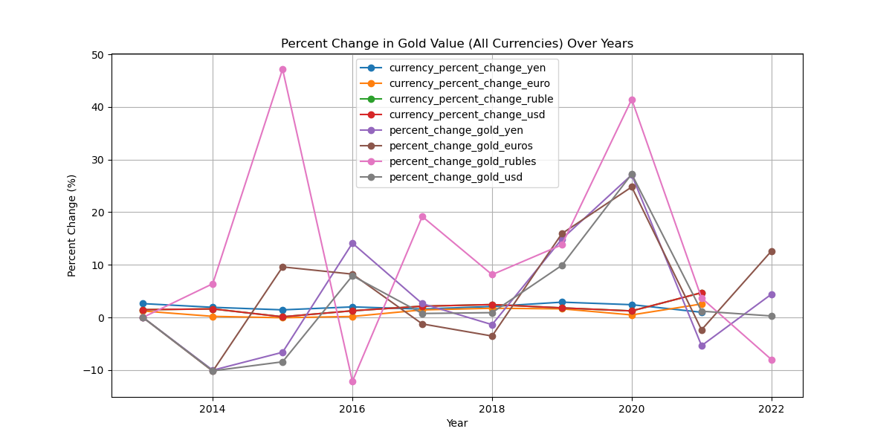
All currency inflation plotting based on percentages
Combined plotting in percentages of inflation

Slide 7
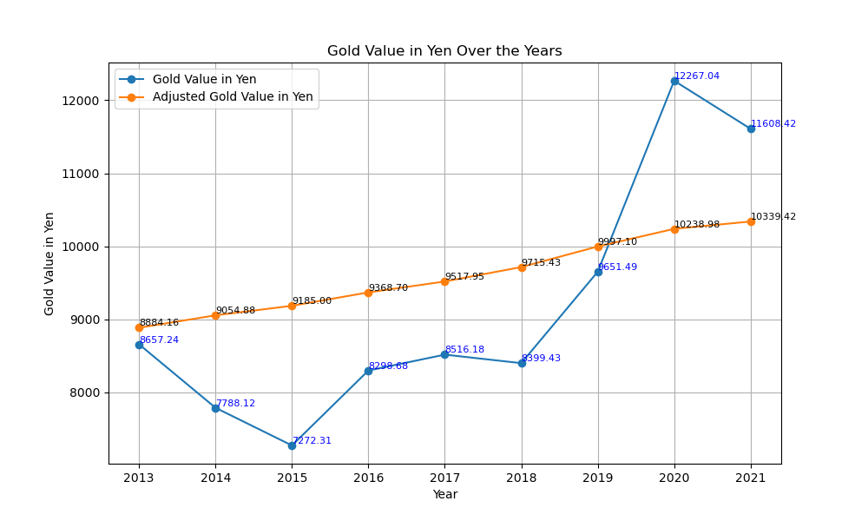
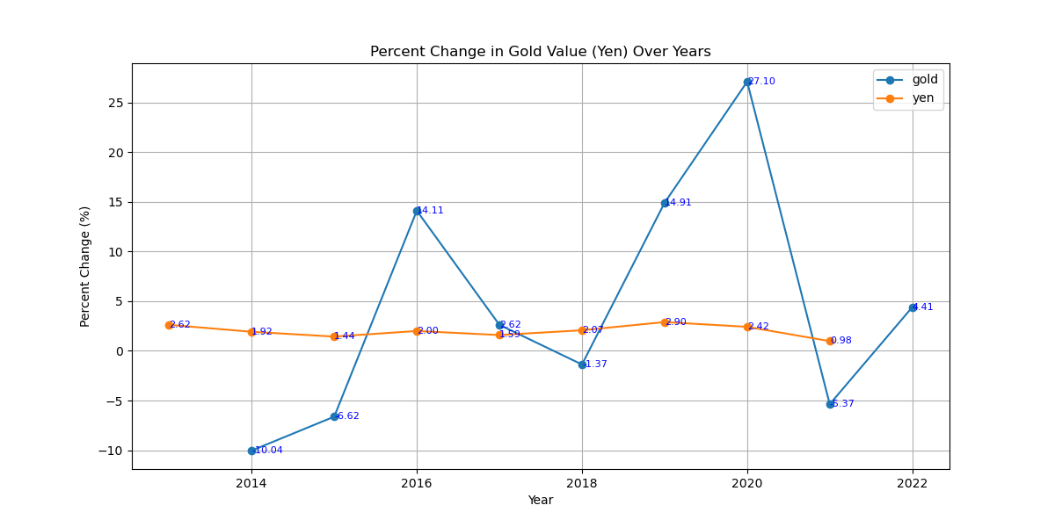
CHINESE YEN
CURRENCY specific plot
In the Gold Value In Yen Over the Years, the Adjusted Gold Value in Yen (the orange line) increases slowly in steps from $8,864.16 to $10,339.42. The orange line is a stable increase.
Whereas The Gold Value in Yen (the blue line) has an unstable change.
In the Percent Change in Gold Value (Yen) Over Years, the gold value (blue line) is stable. Whereas the Yen value (orange line) has an unstable change.

Slide 8
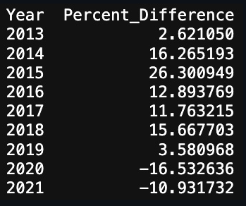
China / Yen Analysis
In the Gold Value In Yen Over the Years, the Adjusted Gold Value in Yen (the orange line) increases slowly in steps from $8,864.16 to $10,339.42. The orange line is a stable increase. Whereas The Gold Value in Yen (the blue line) has an unstable change. In the Percent Change in Gold Value (Yen) Over Years, the gold value (blue line) is stable. Whereas the Yen value (orange line) has an unstable change.

Slide 9
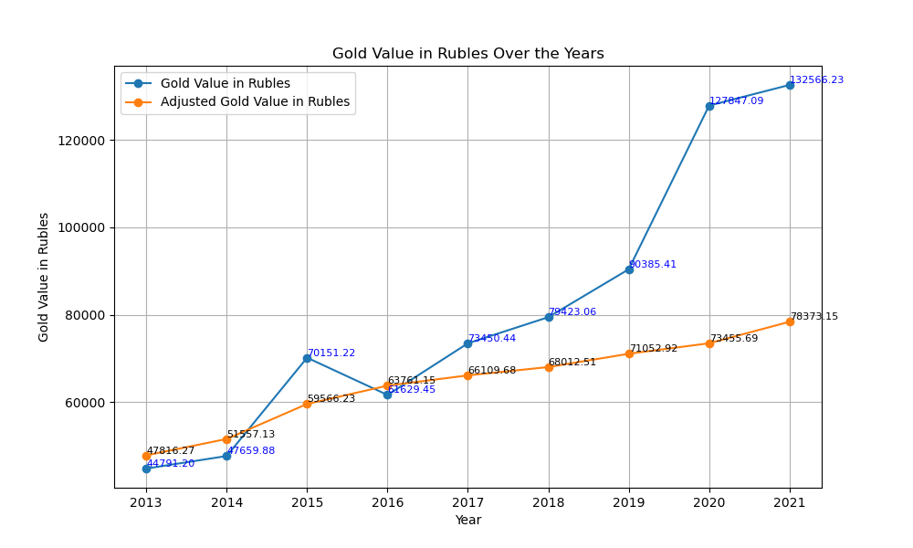
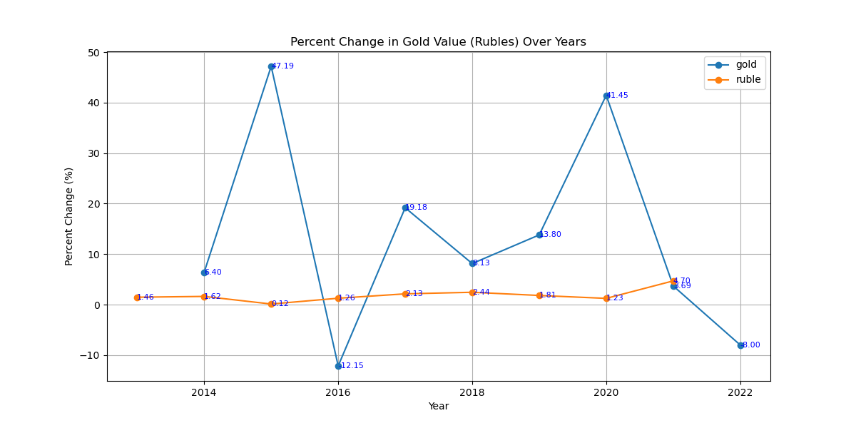
Russian ruble
CURRENCY specific plot
In the Gold Value in Rubles Over the Years graph, the gold value in rubles (blue line) increases from $44,792.20 to $132,566.23, it has an unstable change. Whereas the adjusted gold value in rubles (orange line) increases from $47,816.27 to $78,373.15.
In the Percent Change in Gold Value (Rubles) Over Years, the ruble value (orange line) is stable. The gold value (blue line) has an unstable change it ranges from 6.40% to -8.00%.

Slide 10
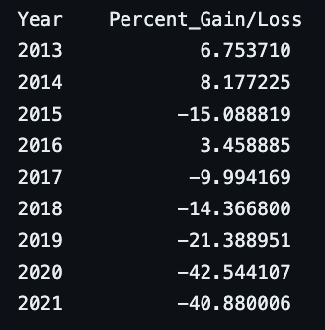
Russia / Ruble Analysis
If one was to immediately swap Ruble to gold upon obtaining the funds one would have avoided a -40% loss in purchasing power while only exposing funds to a risk of 8% in 2014.

Slide 11
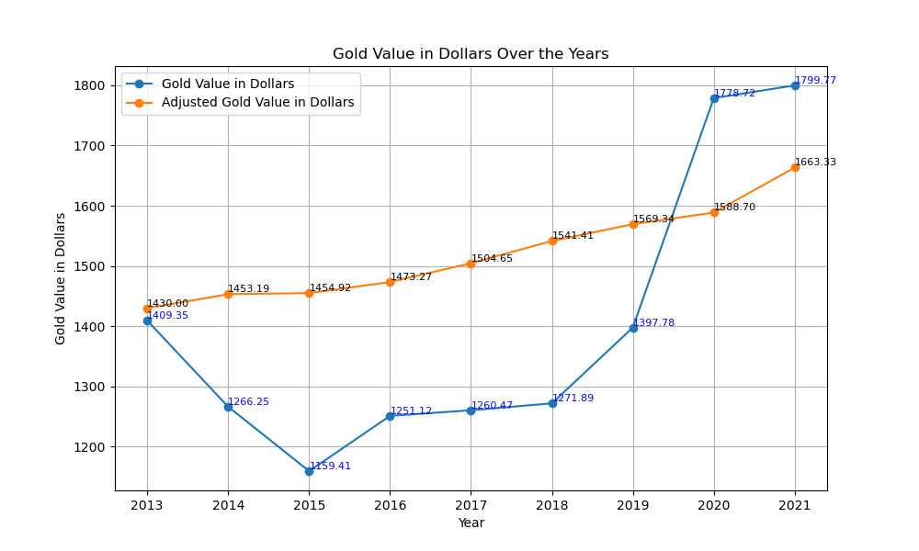
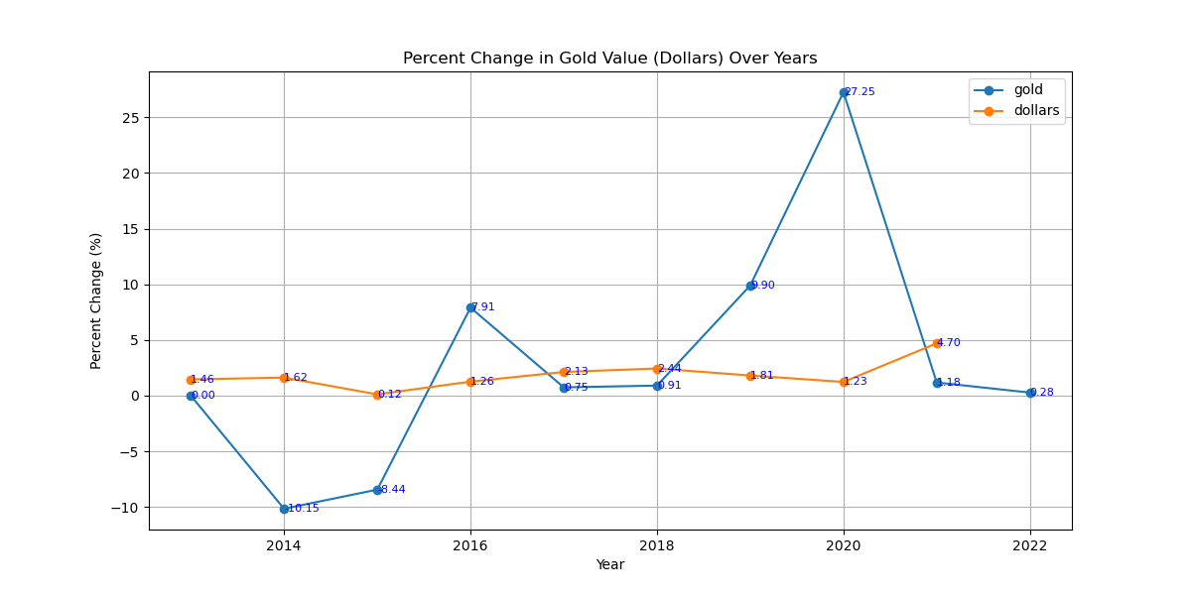
US Dollars
CURRENCY specific plot
In the Gold Value in Dollars Over the Years, the gold value in dollars (blue line) has an unstable change, it ranges from $409.35 to $1,799.77. Whereas, the Adjusted Gold Value in Dollars (orange line) has a stable increase.
In the Percent Change in Gold Value (Dollars) Over Years Graph, the gold value (blue line) has an unstable change. Whereas the inflation (orange line) changes from 1.46% to 4.70%.

Slide 12
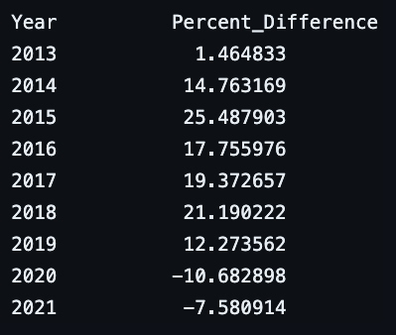
United States / Dollar Analysis
Lowest Percent Change Year was 2020 where there was a -11% change.
Highest Percent Change Year was 2015 where there was a 26% change.
If one were to sell Dollars into Gold during 2015, they would have seen a 55% increase in their currency value accumulated over those 6 years

Slide 13
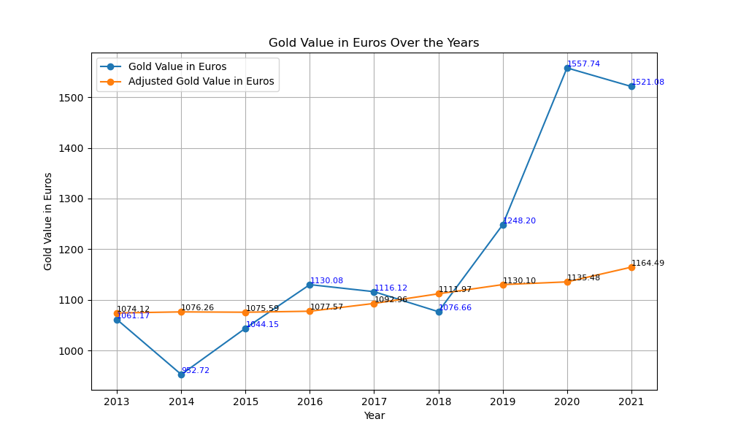
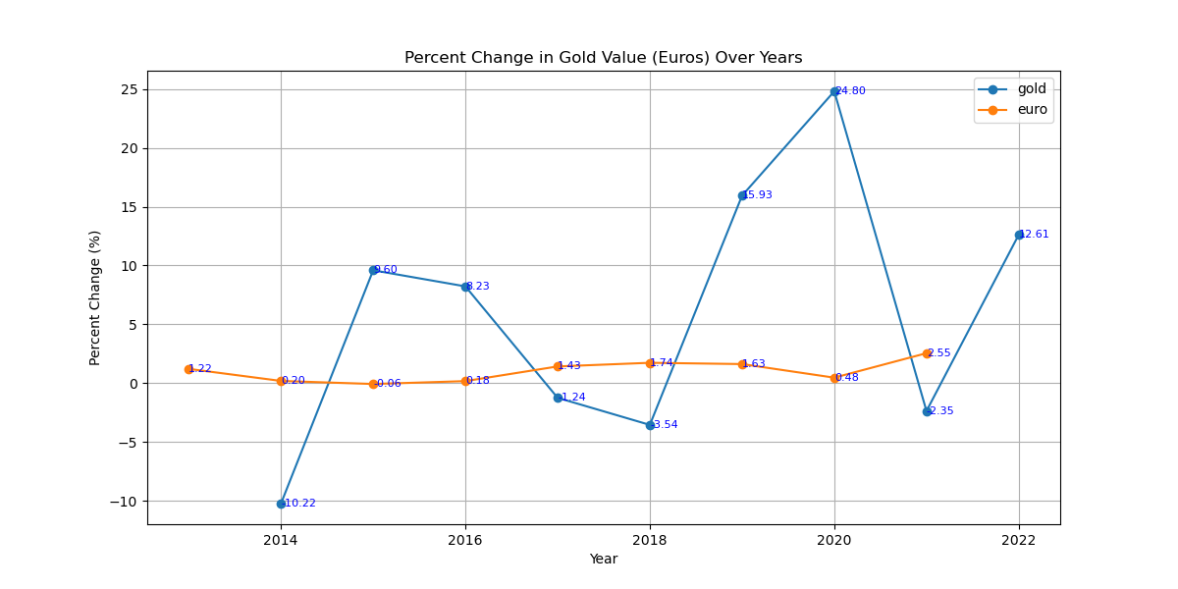
Europe EURO
CURRENCY specific plot
In the Gold Value in Euros Over the Years Graph, the Gold Value in Euros (blue line) has an unstable change. Whereas the Adjusted Gold Value in Errors (orange line) increases from $1074.12 to $1164.49.
In the Percent Change in Gold Value (Euros) Over Years, the gold value (blue line) has an unstable change. Whereas the euro value (orange line) increases from 1.22% to 2.55%.

Slide 14
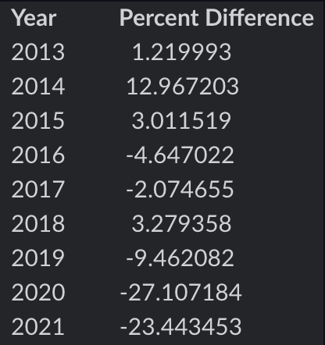
Europe / Euro Analysis
If an individual with Euros had chosen to invest in gold in 2013, they would have seen a 56% increase in purchasing power by the year 2020 if they converted back to Euros that year.

Slide 15
Research Questions / Analysis Conclusion
Where is the money lowest inflation?
Of all the four currencies we observed only two have recovered post 2020 – The Ruble and the Euro show the highest loss of purchasing power. The Dollar and YEN are proceeding to recover at a similar rate.
What currency experience the highest inflation?
YEN saw the highest inflation in its currency (2020) but also the strongest recovery the following year (2021). Nearly a 25% adjustment to the currencies purchasing power within 3 years. During this three-year period the YEN would be safest kept in currency and then once the orange and blue line flipped buying as much gold as possible in 2021.
Is it profitable to move money?
Depending on the currency you have, the data supports moving currency to gold when the range of percent difference is within single digits for the maximum return.
What currency has the consistent value range for the longest time?
Dollar has the lowest range of value for its currency a 35% range from its best at 25% above gold to its worse at nearly 10% below gold’s stability.
What currency has the least consistent value range for the longest time?
Ruble has the highest range of value for its currency a 46 percent range from its best at 6% above gold to its worse at nearly 40% below gold’s stability.

